Slide 1
Mawlana Bhashani Science and Technology University
Department of Computer Science and Engineering
Course Title: Software Development Project-II and Industrial Tour
Course Code: CSE-3116
Presentation on: File Transferring
Supervised By:
Md. Mahfuz Reza
Assistant Professor
Dept. of CSE,
MBSTU.
Submitted By:
Md. Juwel Mahmud
Id: CE16035
3rd year 1st semester
CSE, MBSTU.

Slide 2
A Presentation on
File Transferring

Slide 3
Contents
Introduction
Purpose
Requirements
Tools
Methodology
Project Module
Outcome
References

Slide 4
Introduction
Our application has a client and a server.
We send a file from the client machine to the server machine.
In this case, we are sending the file as a java object.

Slide 5
Introduction
The object contains the file name , destination path , file content, status of transfer etc.

Slide 6
Purpose
Our purpose is Sending file PC to PC without losing data.
With the system, we can transfer file with highly security.
The system can transfer file to any distance with the help of net connection.

Slide 7
Tools
Operating System : Windows xp,7,8,8.1,10
Environment :Netbeans IDE
Language : Java Socket Programming,
Java swing.

Slide 8
Requirements
Net connection.
IP address.

Slide 9
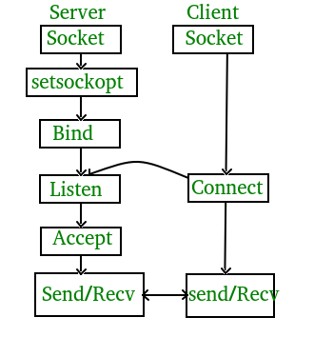
Methodology

Slide 10
Project Module
Module 1- Client Site
Module 2- Server Site
Module 3 – Status Box

Slide 11
Client Site
Client site is the Sender site.
In Client site, IP address will be given in IP field
Then connect with Server site with net connection.

Slide 12
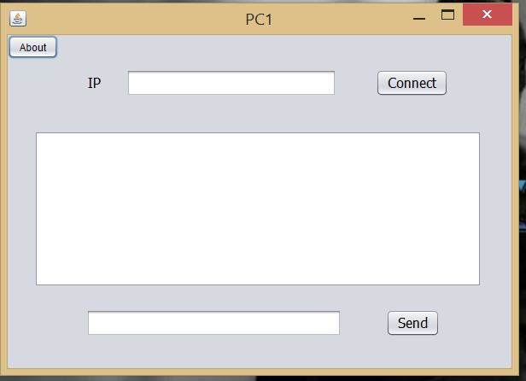
Outcome-Client site

Slide 13
Server Site
Server site is the Receiving Site.
In Server site, IP address will be provided to Client site.
Then waiting for connecting.

Slide 14
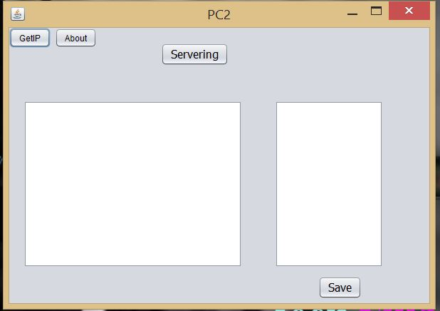
Outcome-Server site

Slide 15
Status Box
Status box shows the status of server site.
It also shows the status of Client site
In the status box we will be easily noticed whether the connection is OK or not.

Slide 16
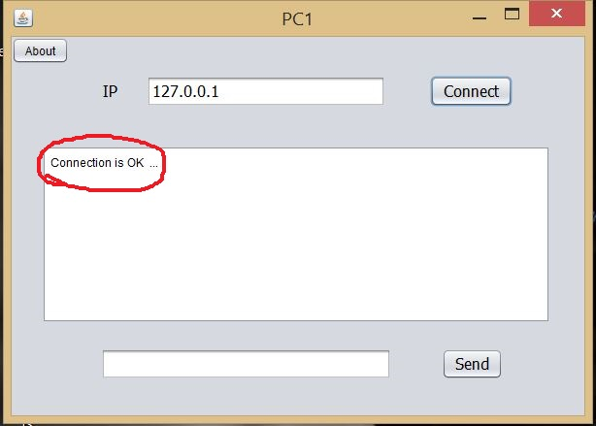
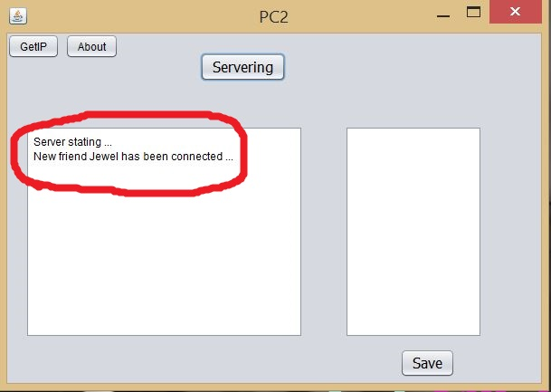
Outcome-Status box

Slide 17
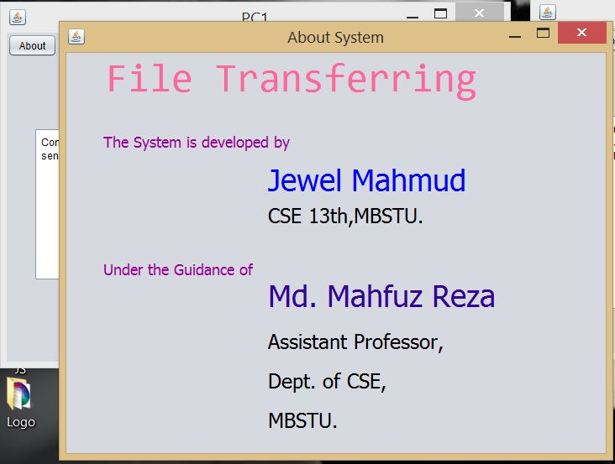
Information

Slide 18
References
https://www.geeksforgeeks.org/socket-programming-cc/
https://www.geeksforgeeks.org/socket-programming-in-java/
https://www.journaldev.com/741/java-socket-programming-server-client

Slide 19
Special thanks to my advisor
Md. Mahfuz Reza sir.

